Slide 1

Modern App Technology Overview:
Building a Modern Web Application
Allen Conway
Lead Consultant
Magenic
Level: Beginner

Slide 2

Intro
Allen Conway
Blog: http://www.AllenConway.net
Twitter: @AllenConway, http://www.twitter.com/AllenConway
GitHub: https://github.com/AllenConway
Email: AllenC@Magenic.com

Slide 3

What we will cover
JavaScript Web Applications Overview
AngularJS
TypeScript
HTML5/CSS3 Responsive Design

Slide 4
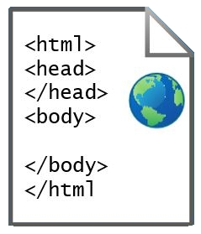
What exactly is a JS Web App??
a.k.a Single Page Applications
What’s with the ‘Single Page’ – Do I have to do everything in 1 page?
HTML web page “shell” is sent once to the browser

Slide 5
At the core: JavaScript Frameworks
Complete client-side frameworks written in JavaScript
Create responsive and performant applications
Popular Frameworks/Libraries
AngularJS
ReactJS
Aurelia
BackboneJS

Slide 6
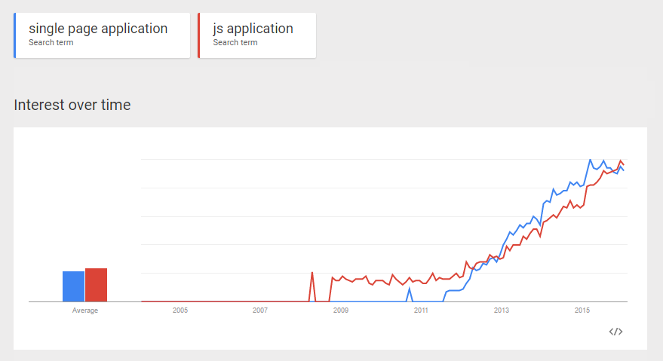
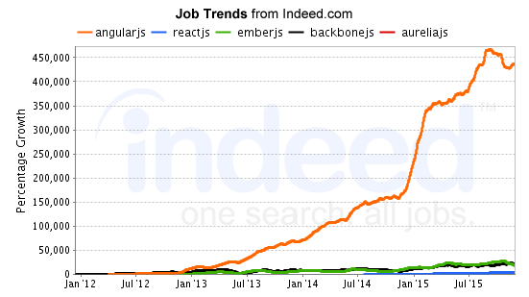
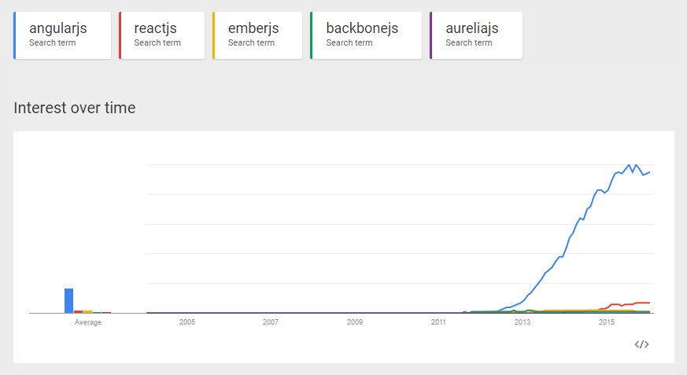
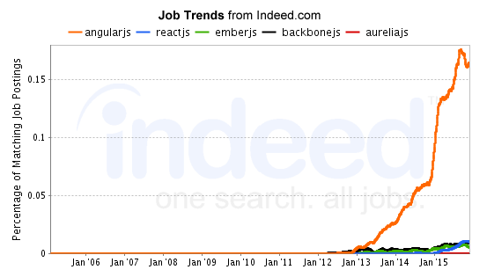
JavaScript Framework Popularity

Slide 7
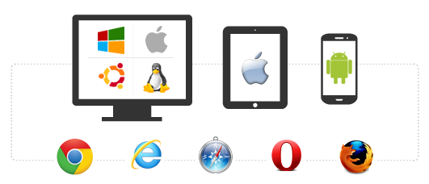
Cross Browser, Platform, Device
JavaScript Applications + Responsive design
Browser and device agnostic
Best on browsers supporting HTML5 and CSS3
http://caniuse.com/
More accepted on mobile devices
JavaScript will rule the world!!
Should I go to the web?
Native per platform
Xamarin
Hybrid/PhoneGap
http://magenic.com/Resources/ID/2

Slide 8


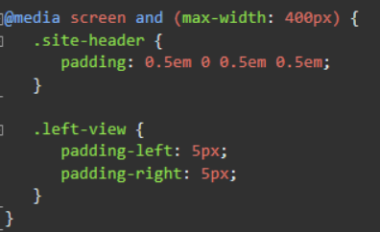
Responsive Design
Further elevate your code :: eyeball ratio
Foot in the door for mobile devices
Invest in your base template
Core technique: CSS Media Queries (CSS3)
Tools for testing
Frameworks
Bootstrap (LESS)
Foundation (SASS)

Slide 9

How are JavaScript Applications different from ASP.NET MVC or Webforms?
Shift in application logic from the server to the client
UI and application logic is now done in the browser
How HTML is delivered
ASP.NET web apps merge data with HTML before delivering to the client
Server’s main responsibility: Data
JavaScript MV* Frameworks

Slide 10

The Basics of Building a Modern Web App
JS Framework
AngularJS
ReactJS
Aurelia
CSS/Responsive Framework
Bootstrap
Foundation
IDE
VS.NET
VS Code
Webstorm
Sublime
Component Managers
NuGet
Bower & NPM
Task Runner
Gulp
Grunt
NPM Scripts
ASP.NET 5
Server Side Options
WebAPI
NodeJS
ORM
Entity Framework
Nhibernate
Dapper
Database
SQL Server
Azure SQL DB (SaaS or IaaS)
Oracle
MongoDB
Deployment Options
Azure
AWS
Google Cloud Platform
In-house

Slide 11

JavaScript and the Modern Web
Let’s not sugar coat it – we need JS
Prototypical Language
Object.prototype.__proto__
Follow mainstream JS patterns and practices
Classes
Modules (Module & Revealing Module Patterns)
Closures
Promises
Leverage JS frameworks and Libraries

Slide 12
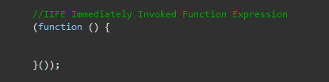
Avoiding JavaScript Goo
Understand the global/public nature of JS
Prevent stepping on our own toes
Avoid polluting the global namespace
Window object
Issues in global namespace
Name collisions and unexpected behavior
ES6 Classes, let, const
ES5 IIFE - "Immediately-Invoked Function Expression“
Used widely in Angular to define modules

Slide 13

TypeScript to the Rescue!

Slide 14

What is TypeScript
High level language like JavaScript yet offering familiar OO concepts and techniques
Superset of JavaScript
All valid JavaScript is valid TypeScript
Transpiled to JavaScript
Microsoft chose to build atop JavaScript
Big wins for TypeScript in Angular 2.0 adoption
Offers compile-time checking for type safety
Provides features ahead of ECMAScript Standards
Pick your favorite IDE
Intellisense!

Slide 15

TypeScript Advantages
Low barrier of entry
Keep those JS skills!
…and flexibility of a dynamic language if needed
Can adopt completely on the server
tsc.exe
Break down the barriers of having ‘MyApp.js’
Scripting language vs. OO style language
Open source from day 1
Maintained by Microsoft, Apache License
#failfast

Slide 16

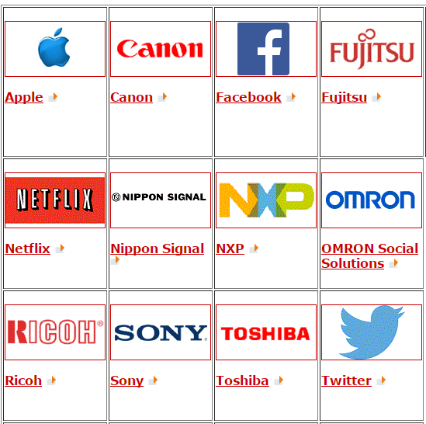
ECMAScript
ECMA-262 ‘ECMAScript’ is the scripting standard
Ecma International is responsible for the standards
ECMA-262 has 6 versions published
TC39: ‘Technical Community 39”
ECMAScript 6 “Harmony” finalized June 2015

Slide 17
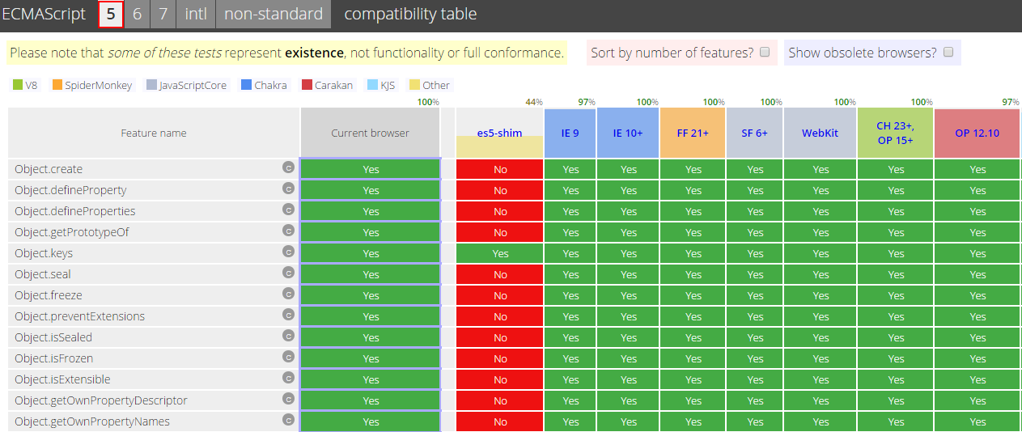
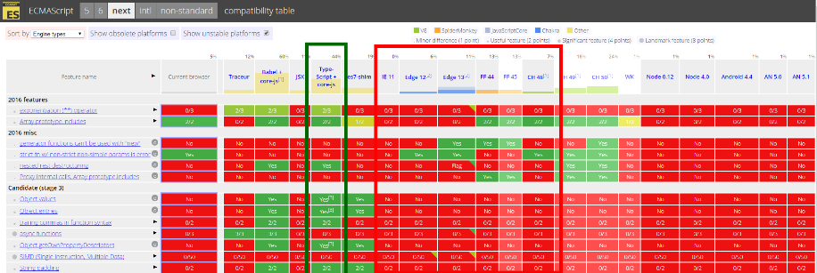
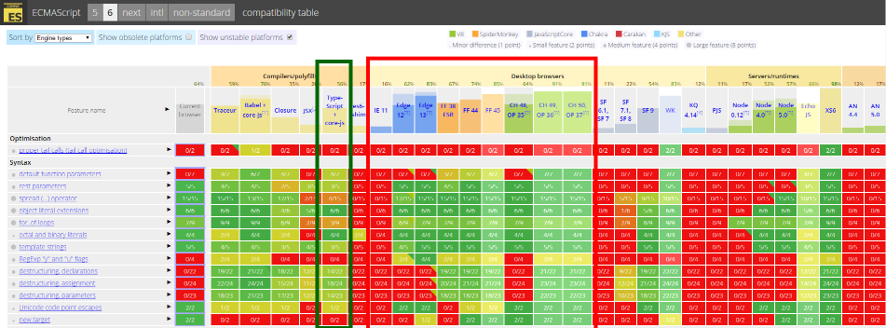
Why TypeScript?
ES5
ES7
ES6
http://kangax.github.io/compat-table

Slide 18
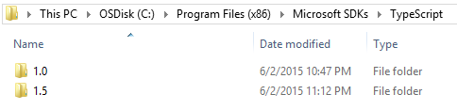
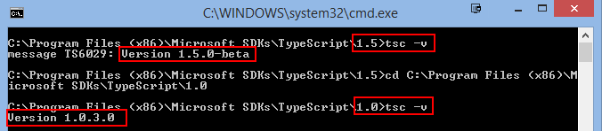

Getting Started With TypeScript
We need the TypeScript compiler tsc.exe
VS2013 Update 2 automatically ships with v1.3
ASP.NET 5 Templates – Use tsconfig.json
Latest version 1.8.6
VS Gallery Extensions (tools), NPM, Bower
Other IDEs can edit TypeScript
Multiple versions can be installed

Slide 19
Getting familiar with the IDE
ASP.NET 4.5 & ASP.NET 4.6/Core 1.0 are very different
Setup tsconfig.json
Exclude .js and .js.map files
TypeScript settings in Project’s Properties
File Nesting (< ASP.NET 4.6)
Start using .TS Files!

Slide 20

TypeScript to JavaScript Language Comparison
Compile time type safety checking
More concise syntax
Syntactical Sugar makes getting from A -> B easier
Familiar keywords
Scope is easier to follow

Slide 21
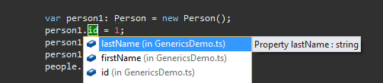
Type Safety in TypeScript
All types are checked at compile time
Optionally statically typed
Dynamic variables using the any keyword
Correct types checked automatically
Types can be explicitly set or inferred
Type annotations are preceded by a ‘:’ and the variable name
var name: string;
var age: number: 30;

Slide 22
TypeScript Modules
Basic structural element
Internal Modules
External Modules
Require.js -> AMD
Common.js -> node.js
Provides additional scope
Use ‘external’ keyword to expose members
Provide namespace capabilities
Group related features
Use ‘import’ to create alias

Slide 23
TypeScript Classes
Basic structural element for organizing code
Familiar implementation
Constructors
Properties
Access modifiers
Inheritance
Scope
Cleaner syntax

Slide 24
TypeScript Interfaces
Used often to define structure and implemented by Classes
Not restricted to classes
Define structure of complex object argument
Provide compile time type checking
Interfaces don’t generate any code (no runtime cost)
Interfaces are open for definition
TypeScript sees a single interface
Particularly useful in AngularJS applications for augmenting $scope in Controllers

Slide 25
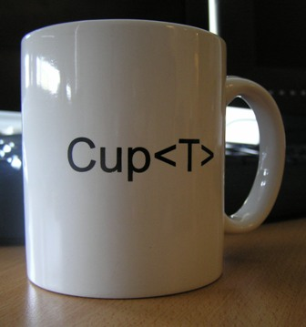
TypeScript Generics
Familiar programming paradigm to allow types to be specified later
Provides flexibility and reuse of internal code
Type safety and compile time checking
Use the <> brackets to specify the type
Proceeds the function, class, or interface name
http://research.microsoft.com/en-us/um/people/akenn/generics/cupt.jpg

Slide 26
Type Definition Files
Leverage Intellisense and strong type checking
The leading repository of TypeScript definitions: DefinitelyTyped
http://definitelytyped.org/
https://github.com/borisyankov/DefinitelyTyped
Get type definition files from NuGet or via Typings
Files exist for most mainstream JS libraries
Popular type definition files:
AngularJS
jQuery

Slide 27

TypeScript and jQuery
Well-known and mainstream JS library
jQuery is valid JavaScript which is valid TypeScript
Type Definition File for jQuery
https://www.nuget.org/packages/jquery.TypeScript.DefinitelyTyped/

Slide 28

AngularJS
Complete client side MVW framework for creating JS Apps
Compliments the server
Originally started at Google, now OSS
Declarative style of programming
Manipulating the DOM
Imperative style of programming
Expressing logic
Easy to use and learn

Slide 29
AngularJS – Directives
Directives are intermediary to provide SoC
ng-* nomenclature defines an Angular directive
Markers on a DOM element
Do not operate on the global namespace
Everything inside of the ng-app directive will be controlled by Angular

Slide 30
AngularJS – Templates/Views
HTML Template
Angular directives,
Databinding {{}},
Controls
Template is combined with information from the model and controller to render view
Main template will contain overall layout
HTML, CSS, and Angular directives
“Partial” views loaded from ng-view

Slide 31
AngularJS – Controllers
Class-like Objects that drive Model and View changes
JS function used to augment the Angular Scope
Provides the application behavior that supports the declarative markup in the template
ng-controller directive
Use an IIFE to prevent pollution
$routeprovider to specify a controller for a template

Slide 32
AngularJS – Models
Encapsulate data and behavior
Model does not touch HTML
Data binding moves model data to the view
Directives provide indirect model view interaction
Leverage caching to prevent multiple roundtrips
Helps keep data out of the root $scope

Slide 33
AngularJS – Services
Allows encapsulating functionality related to a specific function
Angular provides several built in services ($http, $location, $log, etc.)
Services are singletons instantiated once per app
Provide reusable functionality
Services leverage DI via constructor injection

Slide 34
AngularJS – Putting it Together
Page Request
Main Template Delivered
Angular looks for ng-app
Template Traversed
DOM Manipulated
App is bootstrapped
Template is converted into a view
Good idea to use ng-bind on your 1st page as opposed to {{}} so users don’t see an unrendered view

Slide 35
AngularJS playground - Plunker
Plunker (plnkr.co)
Integrated web development environment completely written in AngularJS (proof is in the pudding already!)
Create ‘plunks’ and share with others
Pull in Angular and needed libraries easily
Ability to test and review chunks of Angular, JS, CSS quickly and easily

Slide 36

Angular 2.0 Primer
Component-Based UI
Angular 1.x Controllers & Directives morph into Components
Better performance
$scope is gone
ng-upgrade = Angular 1.x + 2.0
Migrate more easily

Slide 37
Useful References
MyVote URL
http://myvote.azurewebsites.net
MyVote on GitHub
https://github.com/Magenic/MyVote
Plunker
http://plnkr.co/
Bootstrap
http://getbootstrap.com/
UI Bootstrap (Angular directives)
http://angular-ui
Azure Mobile Services
http://azure.microsoft.com/en-us/documentation/services/mobile-services/
Angular 1.x
https://angularjs.org/
Angular 2.0
https://angular.io/
github.io/bootstrap/
AngularJS API Docs
https://docs.angularjs.org/api
AngularJS Training
http://egghead.io/
http://thinkster.io/
http://www.pluralsight.com/
Angular 1 and Angular 2 information
http://angularjs.blogspot.com/

Slide 38

Questions
Thank you for attending Modern Apps LIVE!

